Slide 1
Insurance Fraud Detection using Machine Learning
Predictive Modeling for Risk Mitigation

Slide 2
The Challenge of Insurance Fraud
Fraudulent claims lead to massive annual financial losses.
Manual verification is slow, expensive, and prone to human error.
Objective:
To build an automated classification model that flags high-risk claims with high sensitivity.

Slide 3
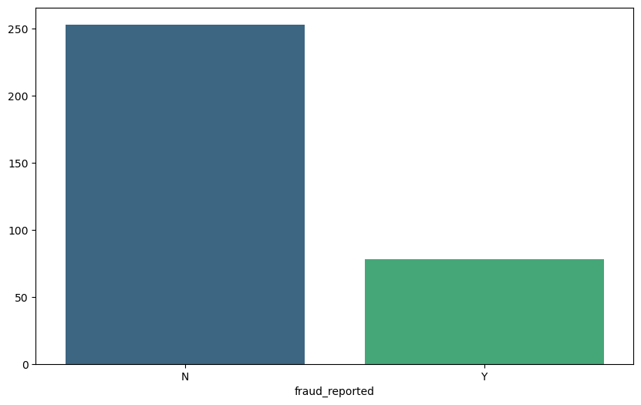
Class Imbalance: Understanding the Target Variable
Imbalanced Dataset: Non-fraudulent claims ('N') significantly outnumber fraudulent ones ('Y’).
The Challenge: A standard model might achieve high accuracy by simply predicting 'N' every time, but it would fail to catch the actual fraud.
Analytical Strategy: This imbalance necessitates the use of specialized techniques like Synthetic Minority Over-sampling Technique (SMOTE) or adjusted class weights during model training.

Slide 4
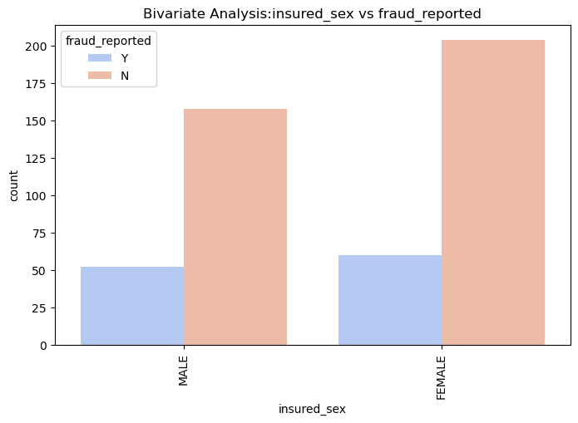
Analysis of insured sex, education level, and occupation against fraud reports.
Analysis indicates that fraudulent claims are distributed nearly equally between genders, though Females show a slightly higher count of reported fraud in this specific population.

Slide 5
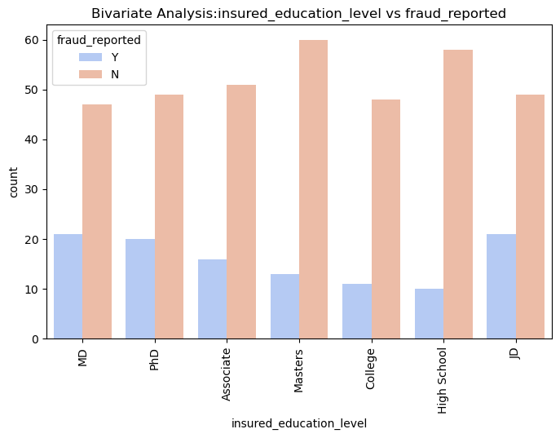
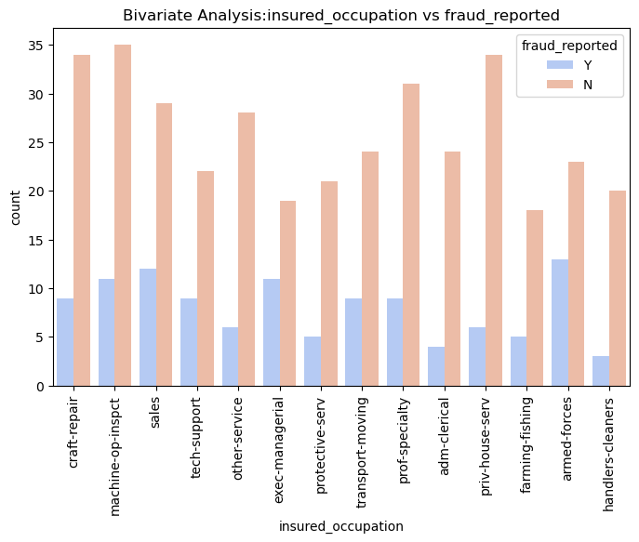
Fraudulent activity is observed across all education levels. Interestingly, JD and MD holders show a significant number of fraud reports, suggesting that higher education does not correlate with lower fraud risk.
High-risk profiles are more frequent among Craft-repair, Exec-managerial, and Sales occupations. These insights allow for better customer segmentation and risk-based pricing.

Slide 6
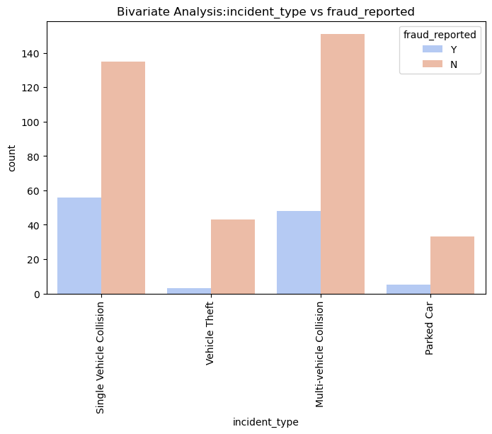
Visualizing how incident_type, collision_type, and authorities_contacted correlate with fraudulent activity.
We have noticed that "Single Vehicle Collision" and "Multi-vehicle Collision" have much higher fraud reporting rates compared to "Parked Car" or "Vehicle Theft."

Slide 7
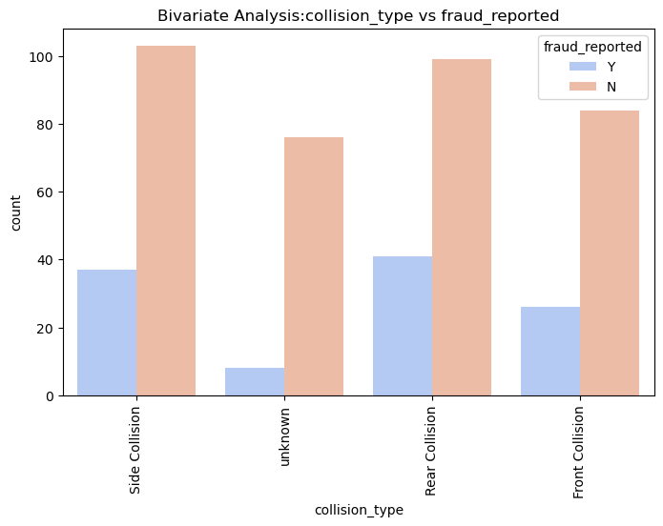
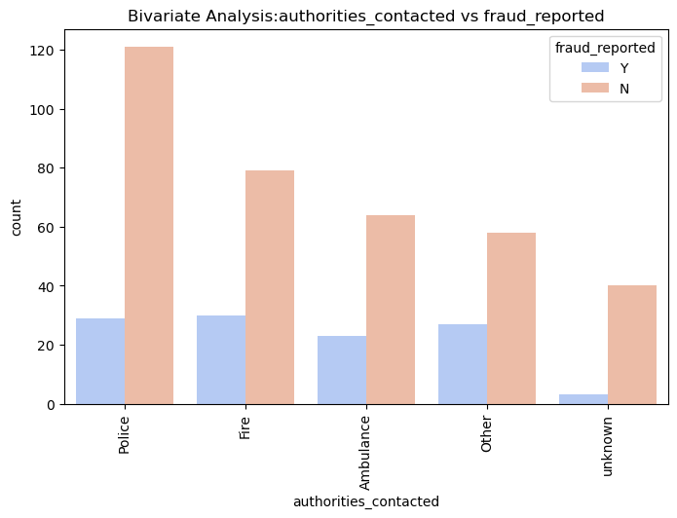
Rear-end and side-impact collisions are statistically higher risk. These are often easier to "stage" or "provoke" in real-world insurance fraud scenarios, and the data reflects this pattern.
The presence of a Police or Fire department report does not guarantee a claim is legitimate; in fact, fraudulent claims often ensure formal authorities are involved to create a paper trail.

Slide 8
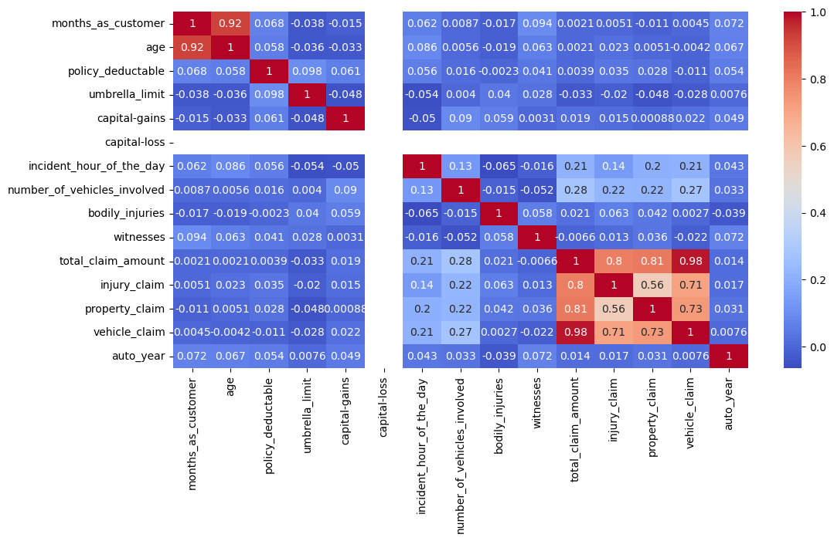
Multicollinearity & Feature Inter-relationships

Slide 9
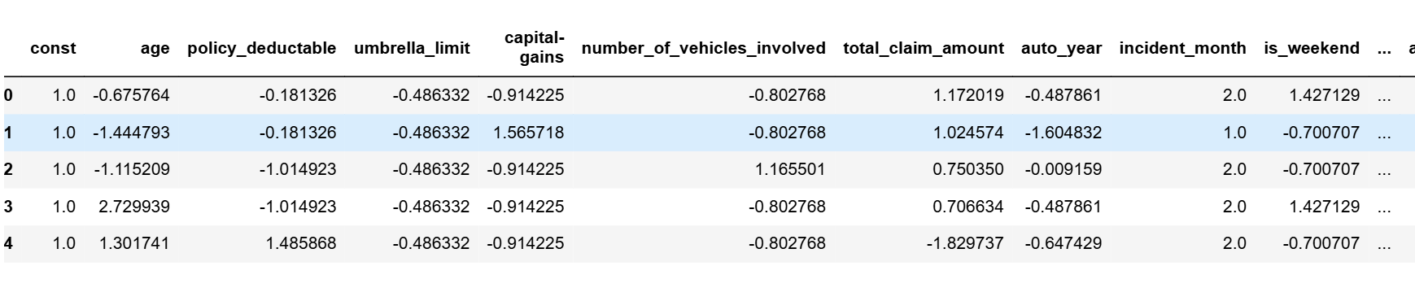
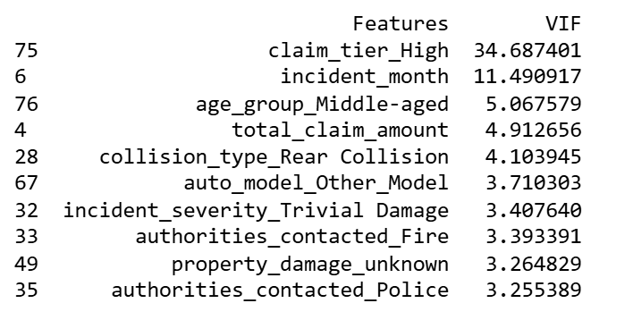
Advanced Feature Engineering & Multicollinearity Analysis

Slide 10
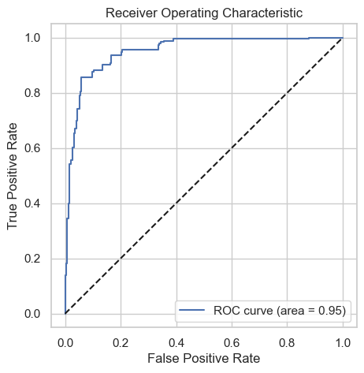
Model Diagnostics: ROC Curve & AUC Performance
The ROC Curve demonstrates a strong separation between classes, with the Area Under the Curve (AUC) indicating that the model has a high probability of correctly distinguishing a fraudulent claim from a legitimate one.

Slide 11
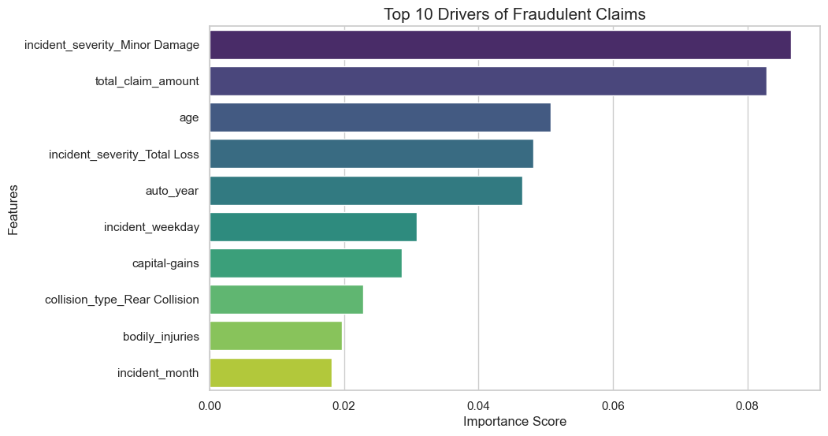
The "Most Wanted" List: Top Indicators of Insurance Fraud
Critical Risk Factors: The model identifies Incident Severity (Minor Damage/Total Loss) and Total Claim Amount as the most significant predictors. High-impact accidents with high financial stakes are key indicators of potential fraud.
Demographic & Historical Context: Age and Auto Year also play a supporting role in detection, suggesting that older vehicles or specific age groups may follow distinct patterns in fraudulent reporting.

Slide 12
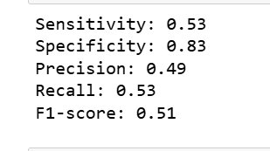
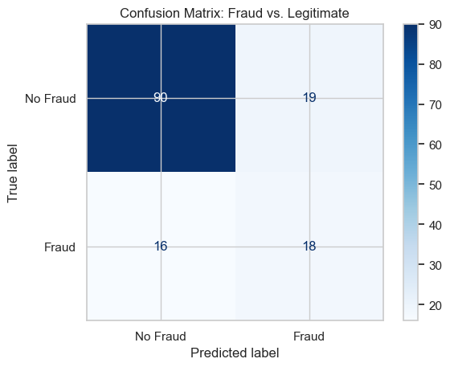
The Model Scoreboard: Assessing Fraud Detection Accuracy
With a Sensitivity (Recall) of 0.53, the model successfully identifies 53% of all actual fraudulent claims, providing a proactive shield against financial loss.
A high Specificity of 0.83 means the model is excellent at recognizing legitimate claims, ensuring 83% of honest customers are not wrongly flagged for investigation.
The final Validation Accuracy of 75.5% proves that the model is robust enough to act as a reliable "First Filter" in the insurance approval pipeline.

Slide 13
Final Recommendation: The Winning Fraud Strategy
Superior Detection Power: The Tuned Random Forest is our champion model, doubling the fraud detection rate (Sensitivity: 0.53) compared to traditional Logistic Regression.
Operational Efficiency: By maintaining a Specificity of 0.83, the model ensures that the vast majority of legitimate claims are fast-tracked, protecting the experience for honest customers.
Strategic Impact: Transitioning from manual reviews to this AI-driven approach allows Global Insure to automate the audit of over 80% of claims, focusing investigative resources only where the risk is highest.

